Slide 1

Week 2 – Workshop
CO456 Web Development

Slide 2
Kahoot Quiz
Please head to kahoot.it within a web browser on your Computer or Mobile.

Slide 3
Technologies you should now be aware of…
HTML
Use of forms, tables and tags for adding content.
CSS
Inline Styling, and <style> tags.

Slide 4
Your Task
Based on your Week 1 task, your aim is to create a Knowledge-base website, which includes the following HTML features:
Text controls
Hyperlinks
Lists
Tables
Images

Slide 5
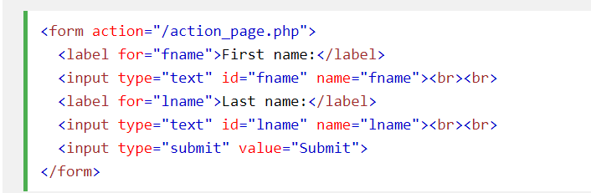
Bit of a recap – Text Controls

Slide 6
Bit of a recap – Hyperlinks
You can also embed images within an anchor tag….

Slide 7
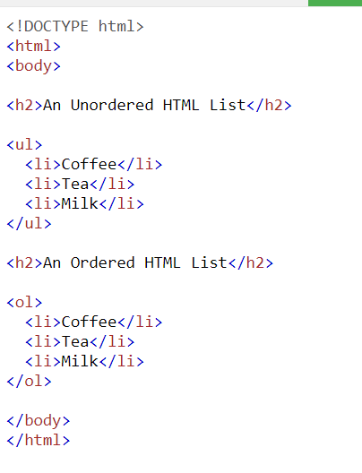
Bit of a recap – Lists

Slide 8
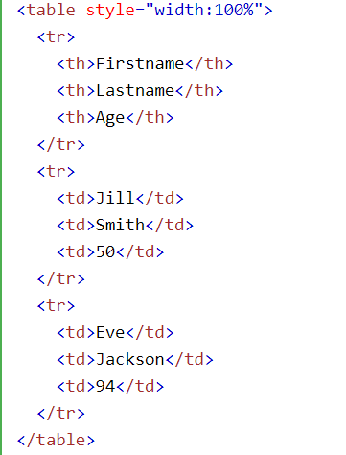
Bit of a recap – Table

Slide 9

Bit of a recap – Images

Slide 10
References
W3Schools (no date) HTML Tutorial. Available at: https://www.w3schools.com/html/ (Last Accessed: 05/10/2020)

